Slide 1
Natchez Elementary School
August 20-21 SY
Back to School Night

Slide 2
Vision & Mission
Vision
Natchez Mustangs:
Building Successful Communities Through Positive Collaboration
Mission
Through high expectations, quality instruction, and community involvement – all Natchez Elementary School students will grow socially and academically to achieve their maximum potential.

Slide 3
Title I provides federal funding to schools to help students meet the challenging State academic standards
PURPOSE
Title I funds are targeted to schools with high numbers of children from low-income families.
Title I is part of the Every Student Succeeds Act and provides about $15 billion per year in federal aid to local schools across the United States.
More than 55,900 public schools receive Title I funds.
Title I serves more than 26 million children.
US Department of Education
Title I, Part A
Budget Tables
Notes:
Purpose of Title I

Slide 4
Participation
Schoolwide Basis - Funds used to serve all students in order to increase academic achievement.
Use of Title I funds
Improve school’s entire educational program
Provide additional assistance to all students who experience difficulties in meeting the State’s performance targets
Notes:
To be a “schoolwide” school the school must have a free/reduced lunch count of at least 40%, collect and analyze data that affects student achievement, and must develop a comprehensive site plan (School Performancy Plan) and annually review its effectiveness.

Slide 5
Program Funds
Allocated so schools with the most low income students get the most funding
Allocated from the highest percentage down
This chart is an example of four elementary schools and the percentage of students who receive free or reduced lunches.
Notes:
Washington School would receive a higher amount of Title I funds as it has the largest percentage of students receiving free/reduced lunch. Lincoln and Obama would not be eligible to receive schoolwide Title I funds as their FRL rates are too low. (For your own information: Rate when schools can become eligibile to receive schoolwide funds is 40%, WCSD funds down to high 58% percent.)

Slide 6
Title 1
The mission of the Title I Program is to assist eligible Title I schools in their efforts to provide services that will ensure that all children have an opportunity to obtain a high quality education and to achieve proficiency on high academic standards.
Natchez Title 1 Funding:
FACE – Family and Community Engagement
Communities In Schools
Instructional Supplies (classroom supplies, printer ink/toner, paper, etc.)

Slide 7
Family Engagement
Governing Practices
Welcoming all families.
Communicating effectively.
Supporting student well-being and academic success.
Speaking up for every child.
Sharing power.
Collaborating with community.
Building the capacity of staff to engage families.
Board Policy 5200
Notes:
1. Parents and families are active participants in the life of the school, feel welcome, valued and connected to each other.
2. Families and staff engage in regular, authentic, two-way, meaningful communication about student learning.
3. Families and school staff collaborate to support student learning and healthy development both at home and at school.
4. Families are empowered to be advocates for their own and other children , ensuring that students are provided equitable access to learning opportunities.
5. Families and school staff are equal partners in decisions that affect children and families.
6. Families and school staff collaborate with community members to connect students, families, and staff to expanded learning opportunities, community services, and civic participation
7. Staff have access to professional learning opportunities that increase their cultural competency and provide practical, research-based strategies that improve their ability to effectively partner with families.

Slide 8
Educator Qualifications
Teachers must meet Nevada certification requirements
Paraprofessionals are highly qualified
Timely notice given if a student has been taught for 4 or more weeks in a row by a teacher who does not meet the State certification requirements, i.e., long-term substitute

Slide 9
Parents’ right-to-know – school level
Individual report card on your child’s progress
Information on State and local assessments
Right of parents to become involved in the school’s programs and how to do so
Subject matter assessed
Purpose of the assessment
Flexible Virtual meetings
Monthly meetings
Fall & Spring Conferences
Notes:
Besides the information provided in the previous slides, parents can request information on any of these items and the school has to provide it in a timely manner. Report cards quarterly. Information on State and Local Assessments – parents can request more information on state and local assessments, i.e., practice tests, MAP, Brigrance, ACT, etc. What the participation policy is…

Slide 10
Parents’ right-to-know – district level
District report card
English Learner (EL) placement
State or District policy on student participation in mandated assessments
Overall student achievement
Achievement by category
Graduation rates
District performance
Gender
Etc.
Achievement by school
Notes:
These are items not specifically stated in previous slides.

Slide 11
CSI
CSI – Comprehensive support and improvement
The Every Student Succeeds Act (ESSA) allows states the authority and flexibility to set policies, to create timelines for progress, and develop school improvement plans that meet the needs of its students. ESSA offers a favorable change from the “one size fits all” approach to school improvement by providing more flexibility in designating and the reporting school performance. There are three designations of schools identified as in need of school improvement.
The first designation is Comprehensive Support and Improvement (CSI) schools, which in Nevada are:
The lowest performing five percent of schools based on an adjusted Nevada School Performance Framework (NSPF) index score,
All one-star schools on the Rising Stars List, and
High schools with a four-year adjusted cohort graduation rate below 67 percent.
Note: CSI schools are capped at two stars in their designation year, followed by a three- year implementation period.

Slide 12
19-20 SY Data
NSPF
12 pts (17-18 SY) → 18.33 pts (18-19 SY)
Students at High/Moderate Risk
45% of Students (17-18 SY) → 21% of Students (18-19 SY)
Chronic Absenteeism
43% of Students (17-18 SY) → 17% of Students (18-19 SY)
Students proficient ELA at Level 3 or 4
13% of Students (17-18 SY) → 16% of Students (18-19 SY)
Students proficient MATH at Level 3 or 4
6% of Students (17-18 SY) → 16% of Students (18-19 SY)

Slide 13
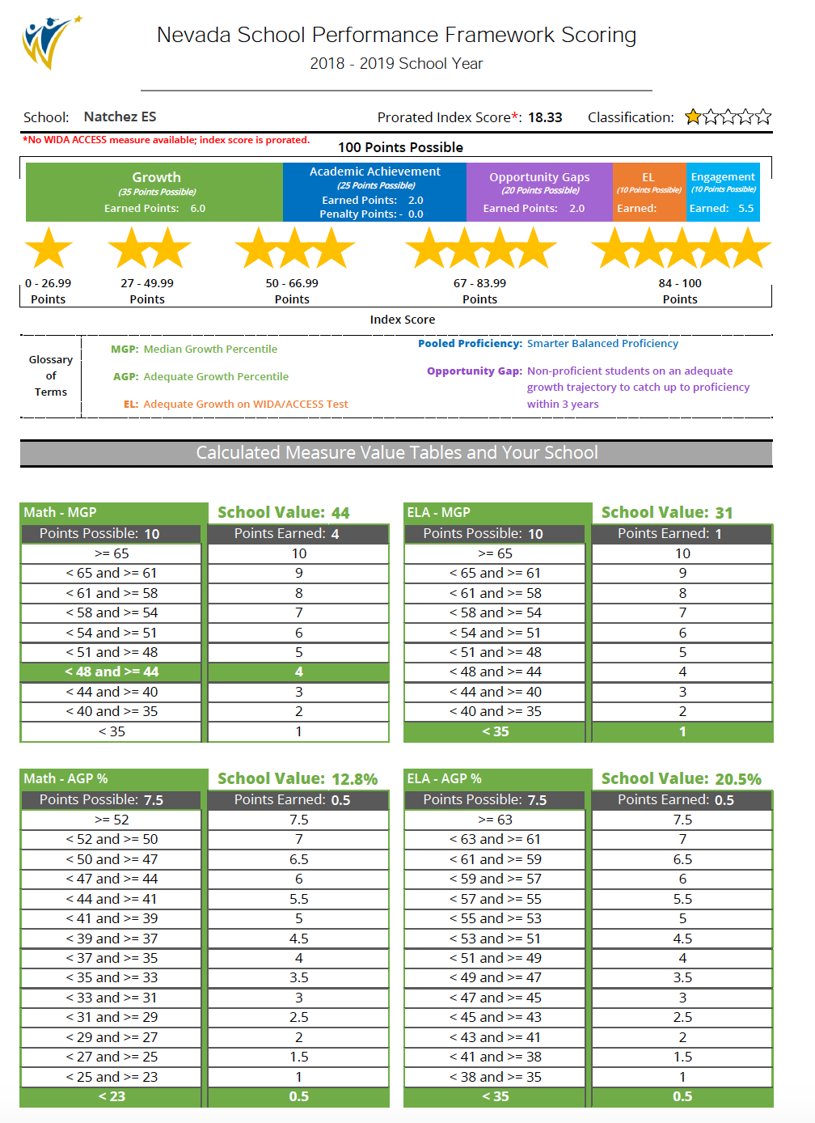
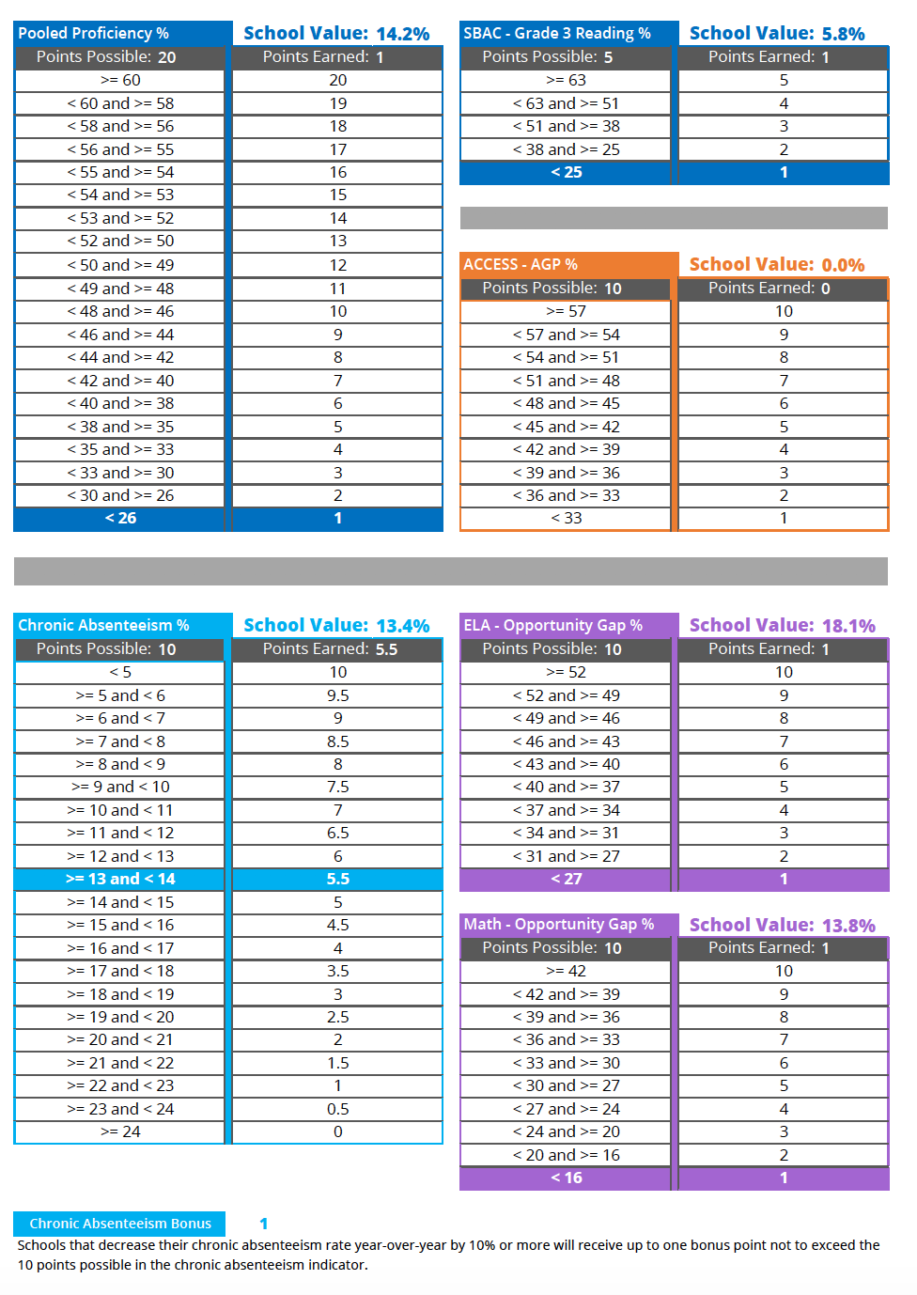
NSPF 19-20 SY

Slide 14
Natchez School Performance Plan
Natchez Elementary School (NES) is a Provision II school of approximately 130 students in grades Prek-5. One hundred percent of students receive Free and Reduced Lunch (FRL). Approximately 78% of students are identified as Tier 2 & Tier 3, 21% have Individualized Education Plans (IEP), and 3% are Children in Transition (CIT). Additionally, Natchez ES has a 29% transiency rate. Currently one student is identified as gifted and talented. Nearly 21% of students are identified as having moderate to high risk according to WCSD risk indices.

Slide 15
Natchez SSP Goals
SPP GOAL #1
Natchez students will exhibit performance that shows achieving higher growth percentiles in both ELA & Math with the SBAC. In 2018-19, AGP data showed that 20% of students were meeting reading state catch-up targets. In 2019-20, AGP data will show an 8-10% increase such that 28-30% of students will meet state catch-up targets in ELA. In 2018-19, AGP data showed that 12% of students were meeting math state catch-up targets. In 2019-20, AGP data will show an 8-10% increase such that 20-22% of students will meet state catch-up targets in math.
SPP GOAL #2
Natchez ES will increase by 15% the number of students meeting their MAP Growth targets for reading and math from Winter 2019 to Winter 2020. 50% of students meet their MAP growth target in reading from Winter 2019 to Winter 2020 and 40% meet their MAP growth target in math from Winter 2019 to Winter 2020. Natchez ES will monitor this progress of growth through standards based common assessments, Smart Goals for students, and data-driven decision making.
SPP GOAL #3
Continued focus on Social Emotional Learning (SEL) and PBIS practices integrated into the classroom and school environment based on Learning Environment on NES Walk-through Form, by increasing the number of observable Teacher and Student SEL/PBIS practices. Decrease the percentage of Chronic Absenteeism to reflect less than or equal to 15% students chronically absent, as well as increase of positive behavior referrals for students meeting the school-wide and classroom expectations of positive behavior.

Slide 16
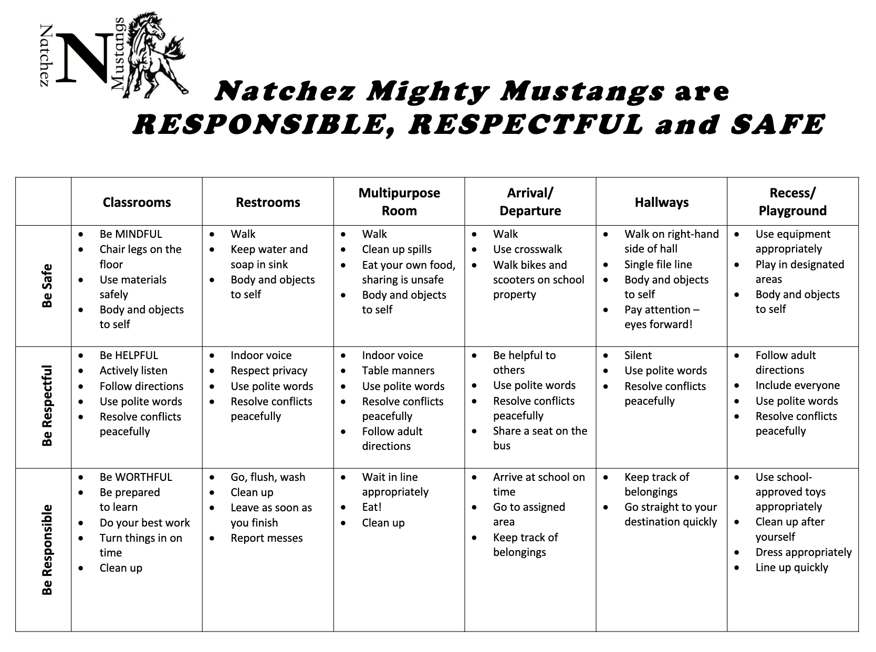
PBIS

Slide 17
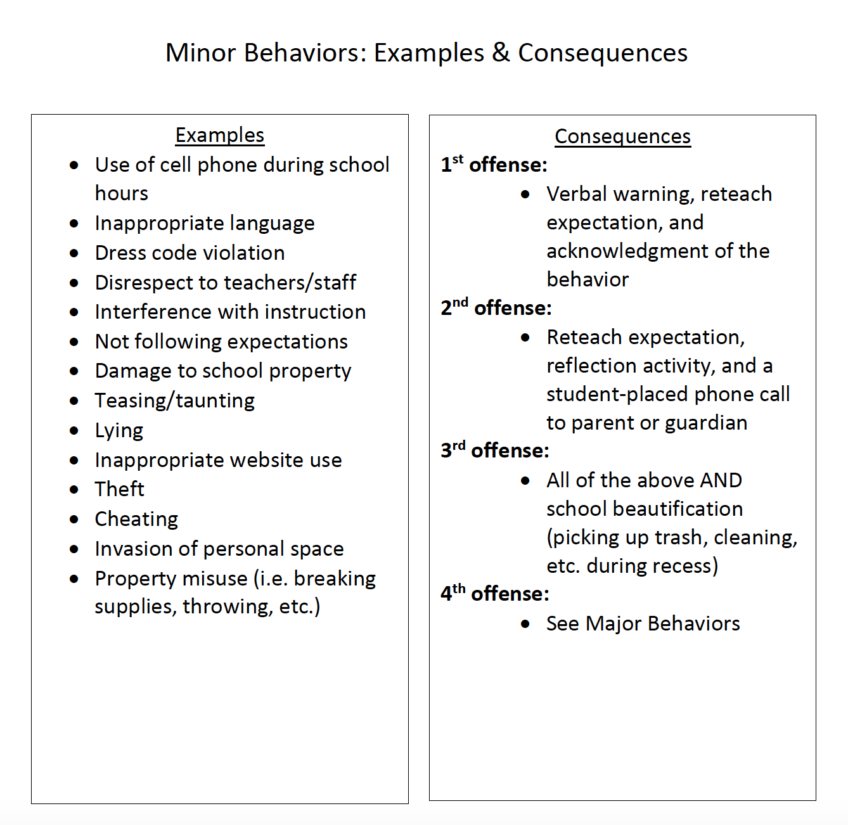
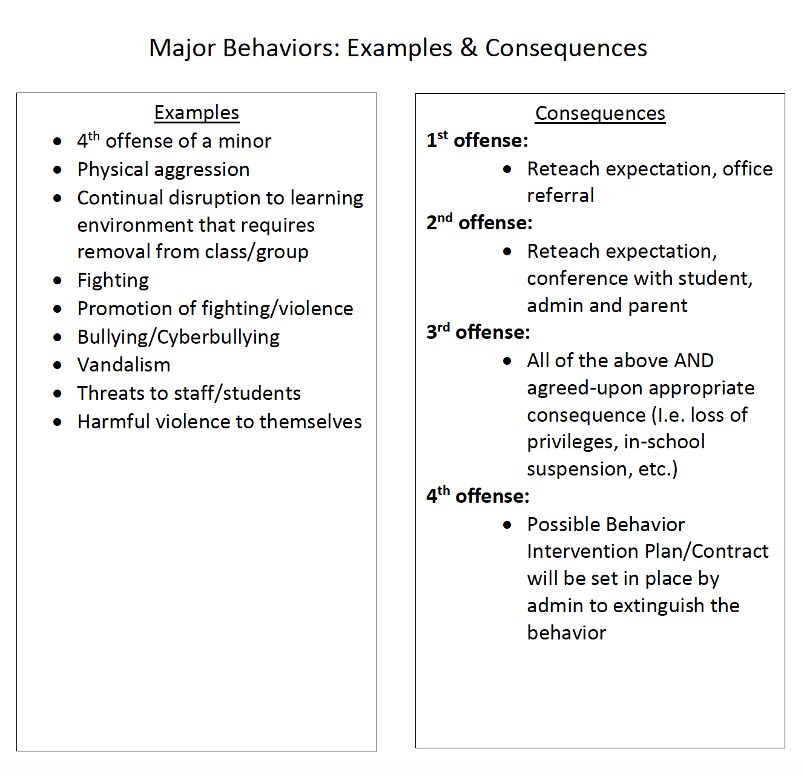
Progressive Discipline Plan

Slide 18
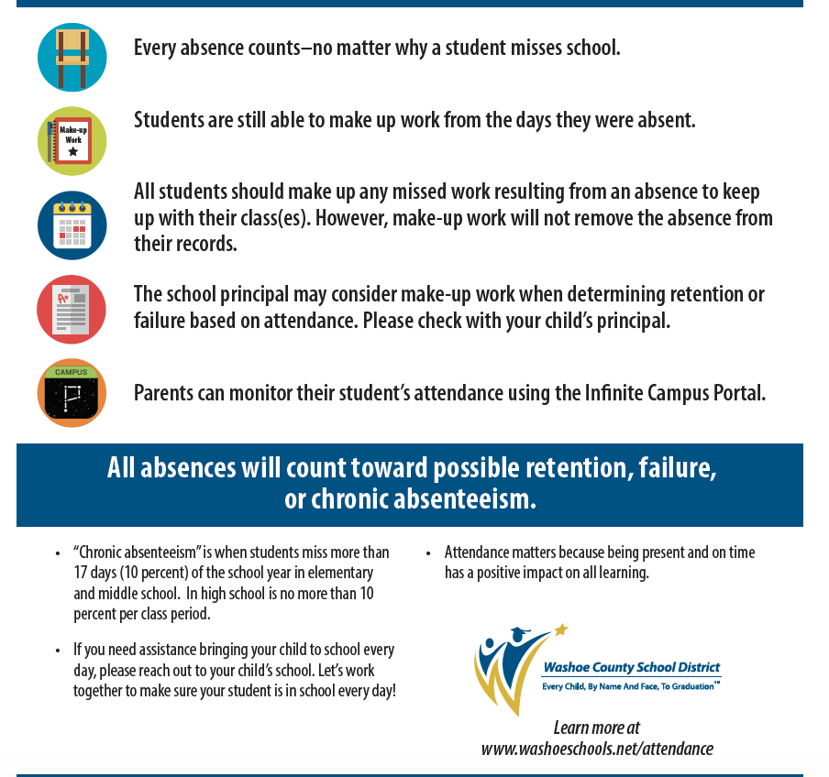
Attendance

Slide 19
Homework Policy
Natchez Elementary has a NO HOMEWORK Policy
Research shows homework does NOT boost learning or promote proficiency
Reading at home
Practice Only and Will NOT be Graded

Slide 20
Team Up/Afterschool
Hiring a New Team-Up Coordinator
Late September

Slide 21
Girls on the Run
SPRING RUN

Slide 22
Natchez ES: 20-21 SY
Scavenger Hunt
Natchez Mustangs:
Building Successful Communities Through Positive Collaboration

